Slide 1


Slide 2


Slide 3


Slide 4
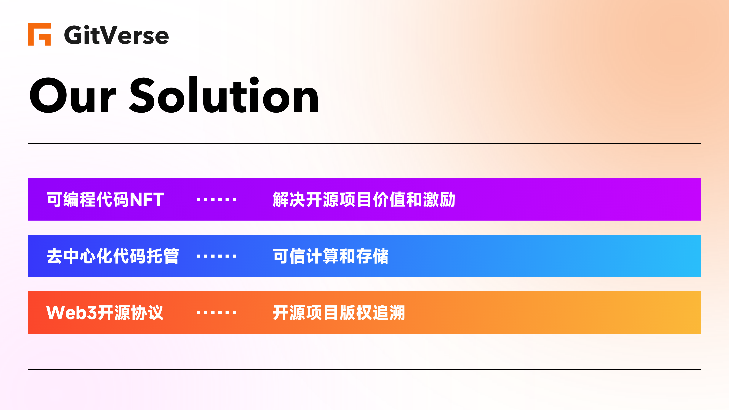

Slide 5


Slide 6
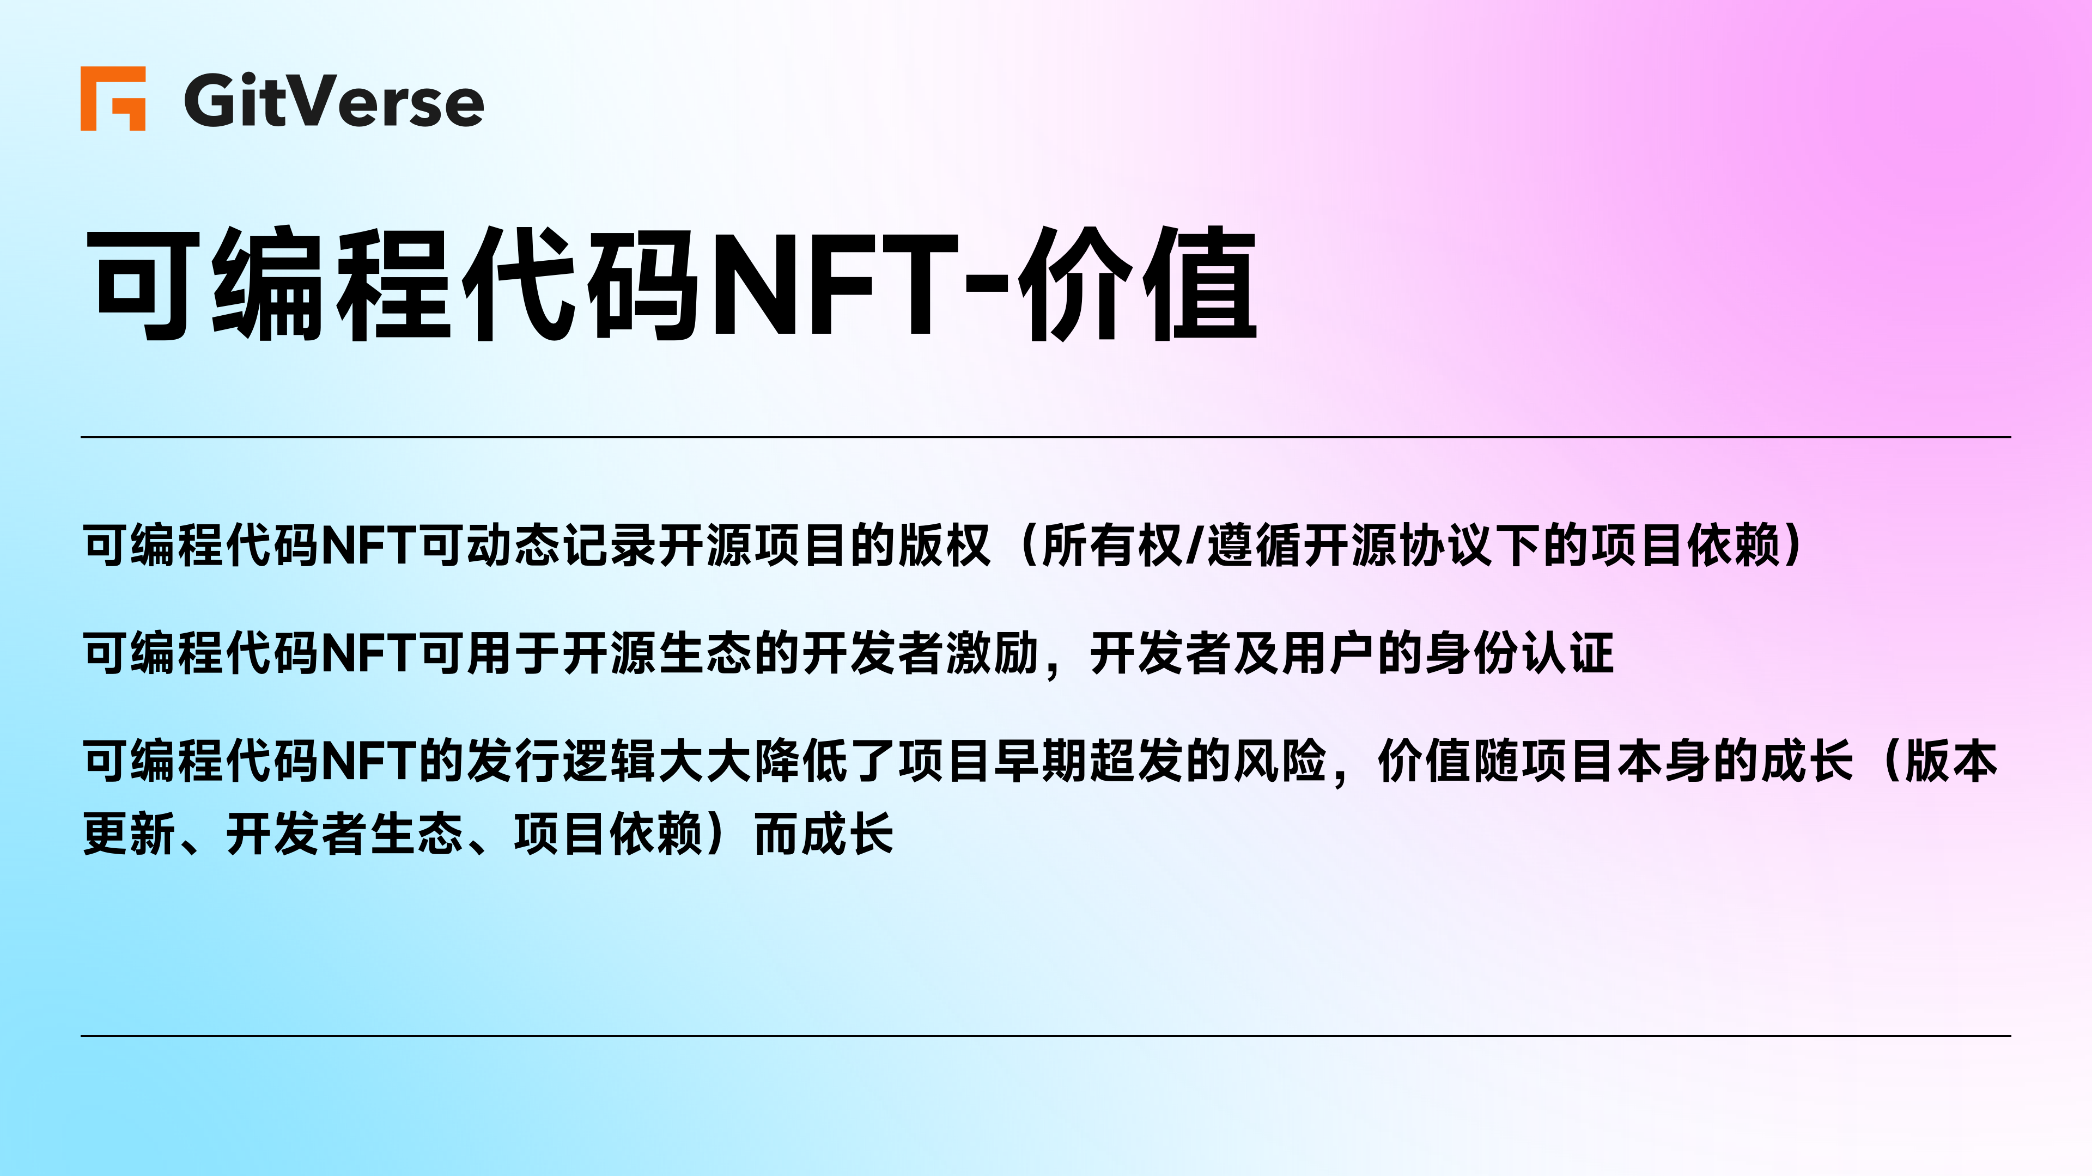

Slide 7
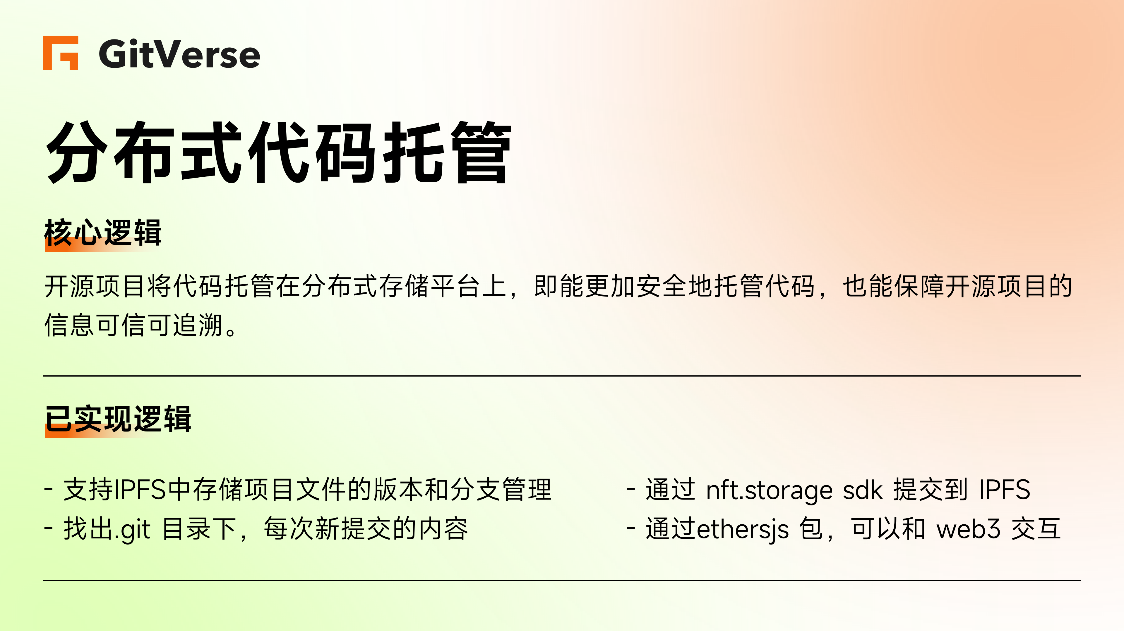

Slide 8
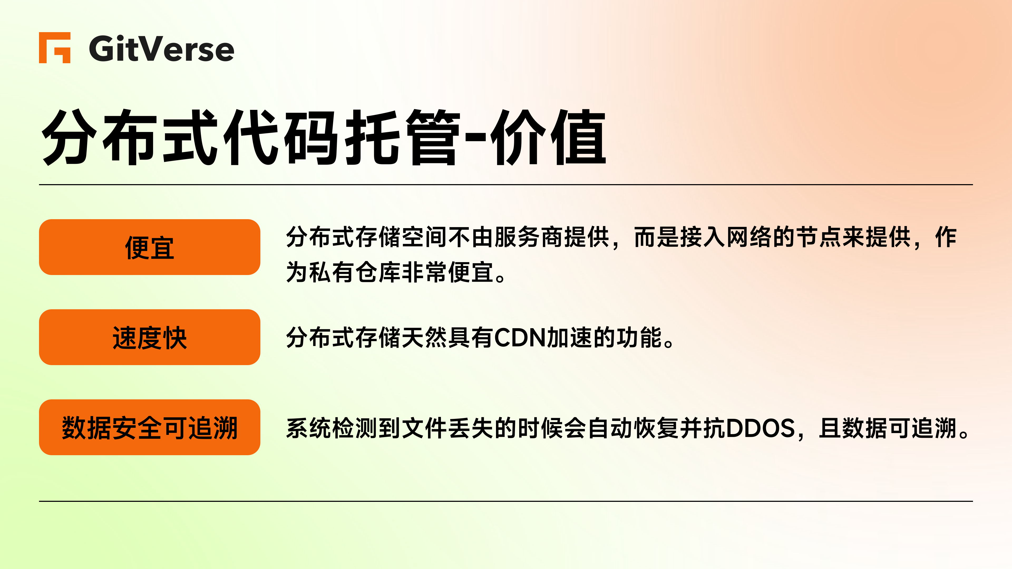

Slide 9


demo链接：https://www.loom.com/share/b94c148c782449ce8c97598b2a8f57f2

Slide 10


Slide 11
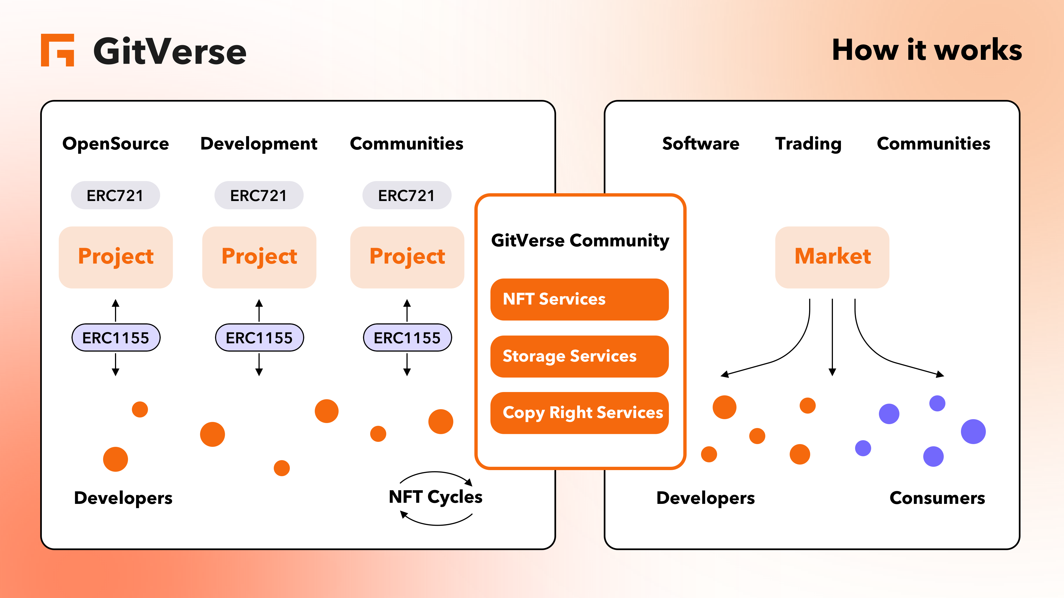

Slide 12


Slide 13
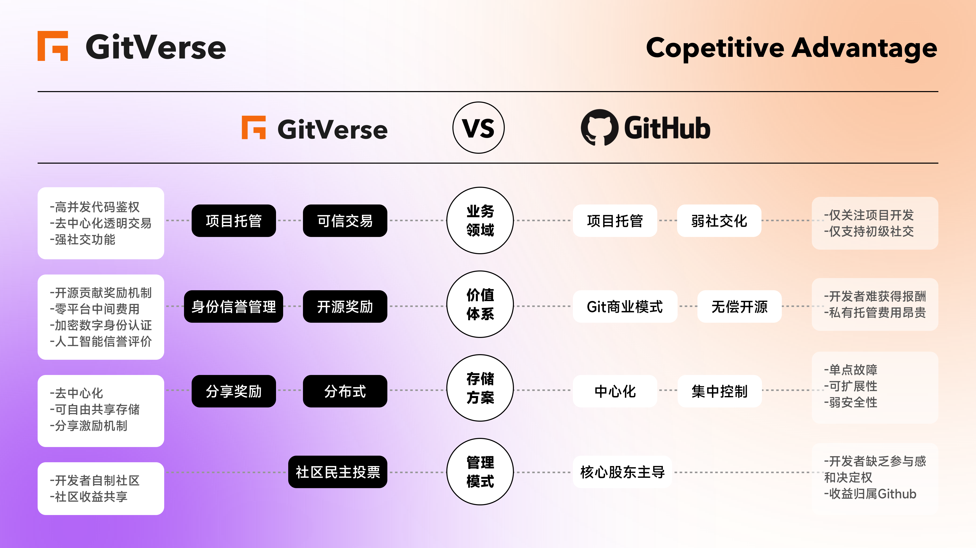

Slide 14


Slide 15
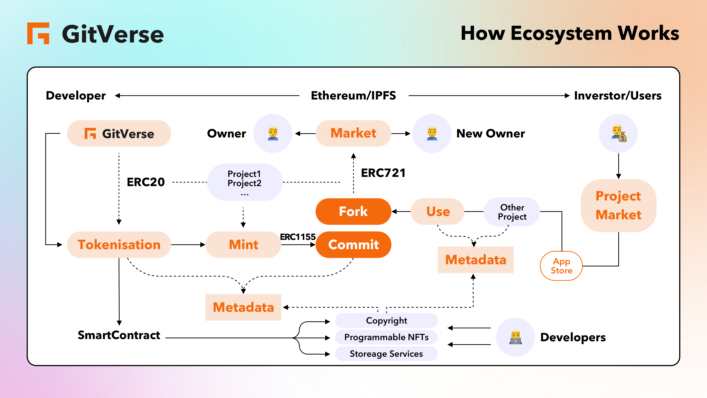

Slide 16


Slide 17


